Slide 1
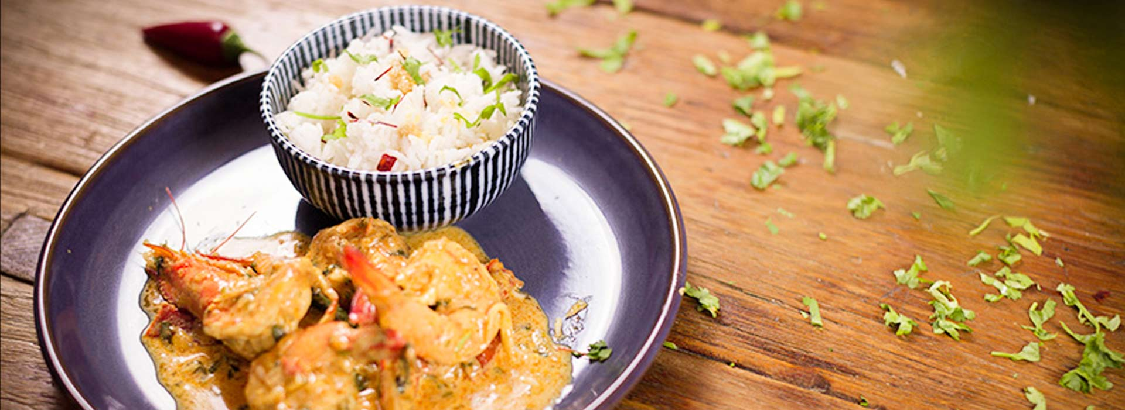
MasterChef Food Blogging Website
Discover the Culinary Delights with us

Slide 2

ABSTRACT ABOUT OUR WEBSITE
WHAT IS FOOD BLOGGING?
THIS IS BASICALLY ABOUT POSTING PHOTOS AND VIDEOS OF VARIOUS RECIPES AROUND THE WORLD IN SOCIAL MEDIA PLATFORMS LIKE INSTAGRAM, GOOGLE, FACEBOOK,TWITTER ETC.
OUR WEBSITE CAN BE EASILY ACCESSABLE THROUGH PHONE,TABLET,COMPUTER.
IT HELPS TO CONNECT PEOPLE GLOBALLY, AS IT MAKES DINING EXPERIENCE MORE INTERNATIONAL.

Slide 3
CLIENT SPECIFICATION
FOOD IS A COMMON FACTOR REGARDLESS OF BACKGROUND, RELIGION OR NATIONALITY. SO OUR GOAL IS TO CONNECT PEOPLE FROM WORLD WIDE THROUGH OUR BLOGGING WEBSITE.
SHARING PHOTOS AND VDEOS OF FOOD WE ARE EATING ALONE REMOVES AN ASPECT OF LONLINESS.
SO WE ALLOW PEOPLE TO POST THEIR EXPERIENCE ON OUR PRESCRIBED FOOD AND ALSO TO SHARES THEIR RECIPES & IDEAS.

Slide 4
People can Discover mouth-watering dishes, cooking tips, and behind-the-scenes glimpses of the foody world.
High-quality images, consistent branding, and a cohesive aesthetic to enhance the overall user experience.
Sponsored Content: Collaborate with food brands, restaurants, or kitchen equipment companies for sponsored posts.

Slide 5
Hardware & Software requirements
Hardwares
We used:
Computer
Pen drive
Softwares
We used:
Chrome
Text editor
Vs code
Html
CSS
jQuery
Bootstrap

Slide 6
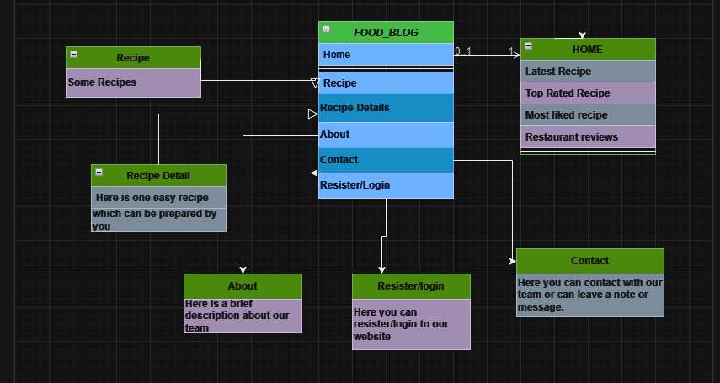
Class Diagram of our Website

Slide 7
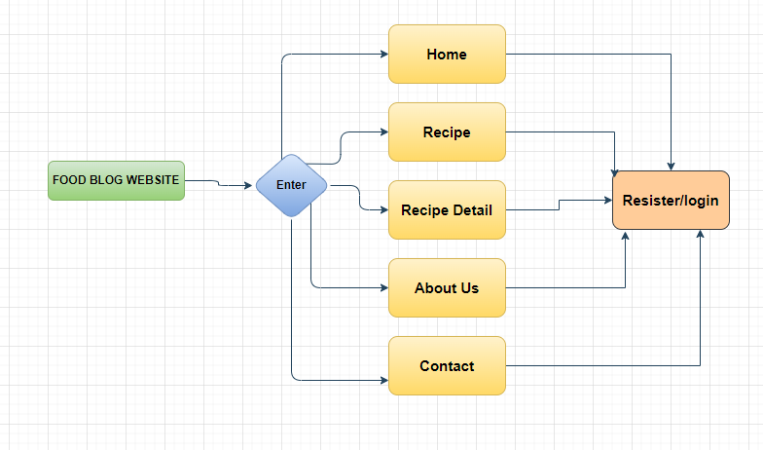
Flow Diagram of our Website

Slide 8
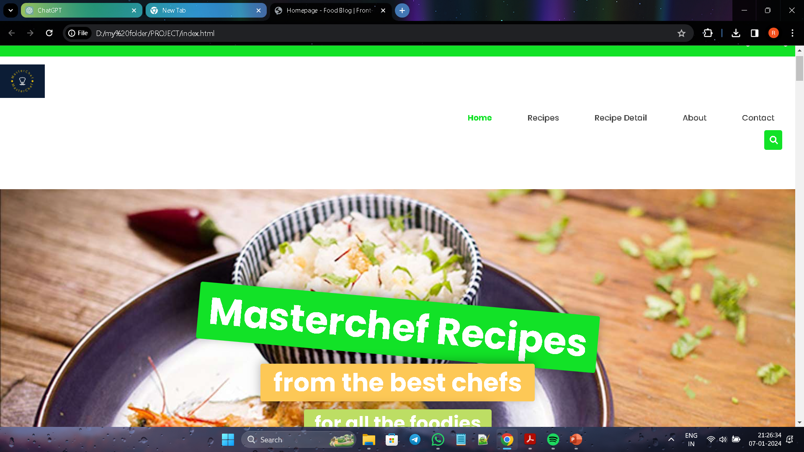
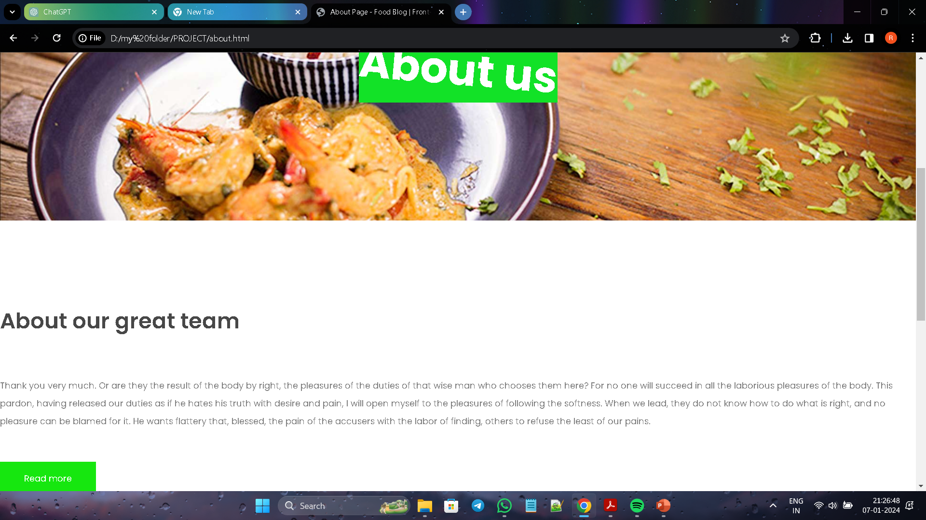
Some Screenshots
INDEX PAGE
ABOUT PAGE

Slide 9
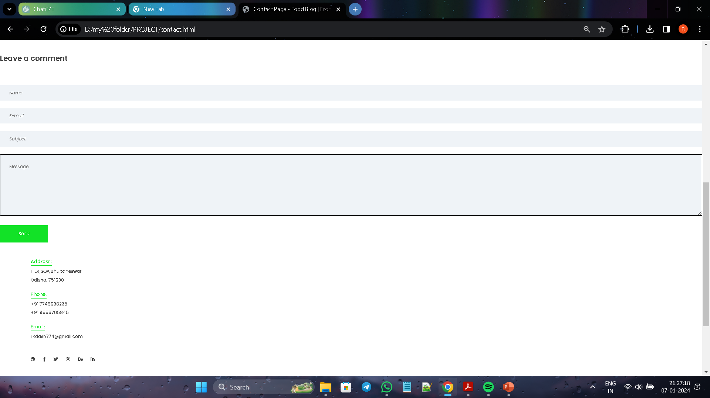
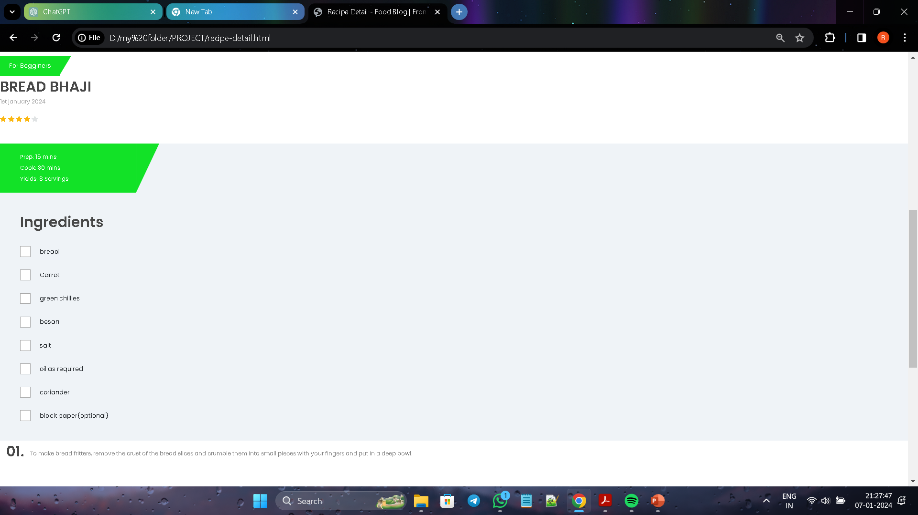
CONTACT PAGE
RECIPE DETAILS PAGE

Slide 10
THANK YOU

